Slide 1
Langchain Agents

Slide 2
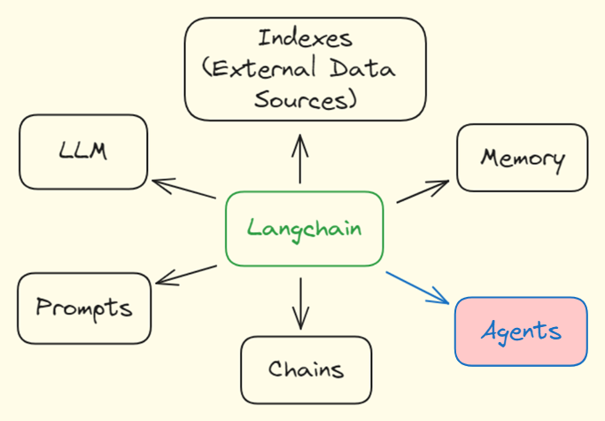
Langchain Framework

Slide 3
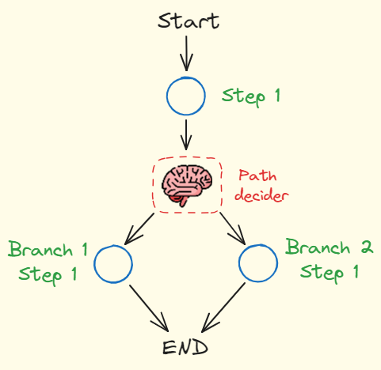
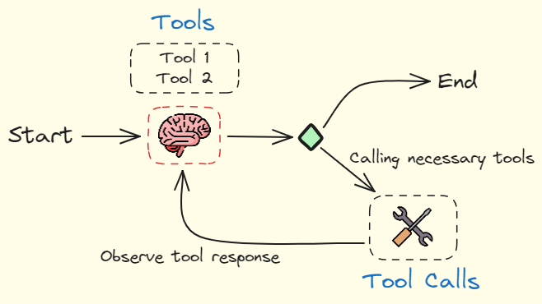
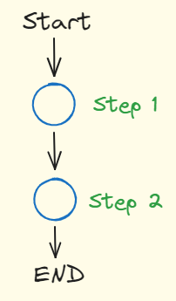
Agent Architectures
Chains | Custom LangGraph Agents | ReAct Agents

Slide 4
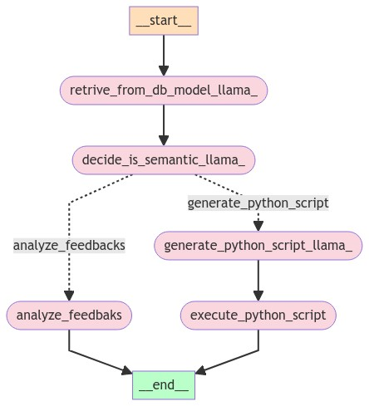
Custom LangGraph Agents Demo

Slide 5
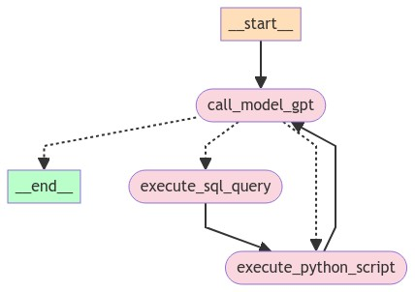
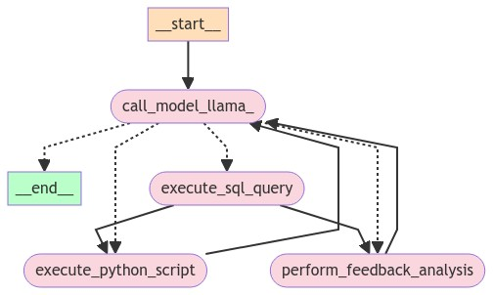
React Agents Demo

Slide 6
Reference
Building and Testing Reliable Agents :- https://www.youtube.com/watch?v=XiySC-d346E&t=3s
Building an Agent to Query a SQL Database and Analyze Data:- https://www.youtube.com/watch?v=NsVnUz7sp_Y&t=10s

